Slide 1
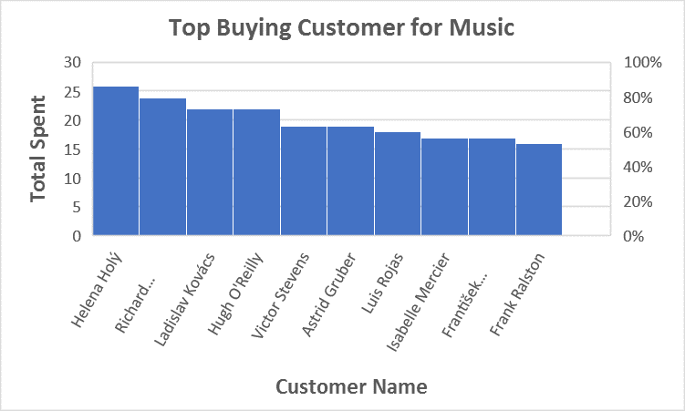
Top 10 best Customer Name
<visualization>
We conclude from the figure Helena Holy is the first customer to spent more money on Music

Slide 2
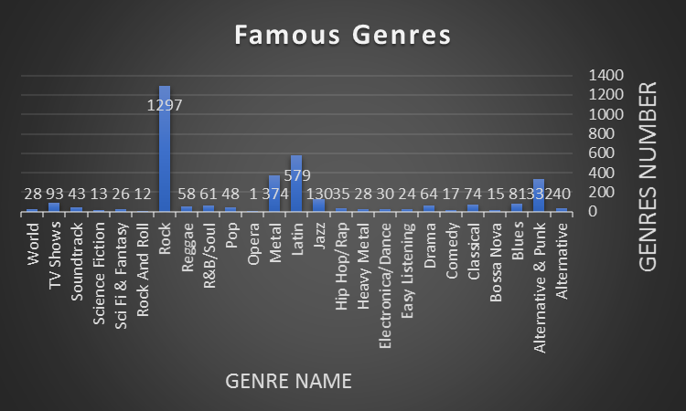
Most Famous Genres of music
<visualization>
We conclude from figure the most famous genre of music is Rock Then Latin

Slide 3
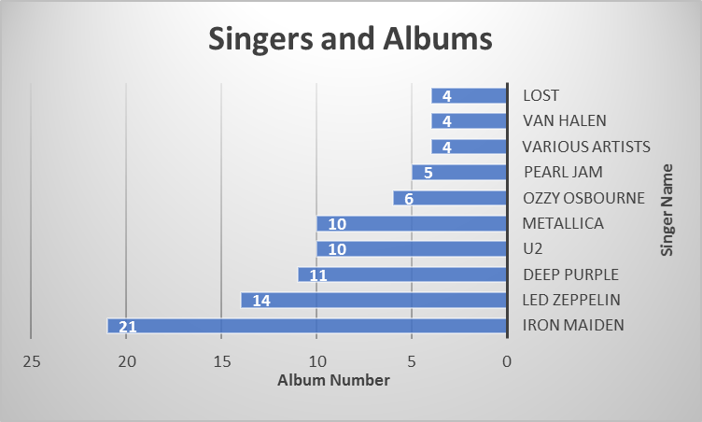
Top 10 Singers and their Albums
<visualization>
We Knew top 10 singers names and their Albums Number and knew the name of the most singer who made Albums is iron maiden

Slide 4
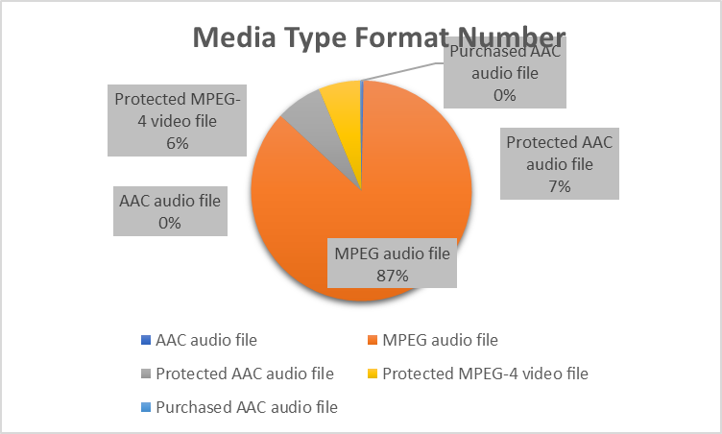
Media type format used
<visualization>
We coclude that the most used media type format is MPEG audio file

